Slide 1
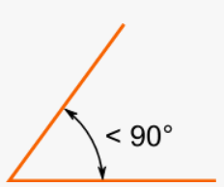
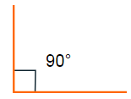
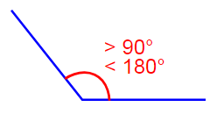
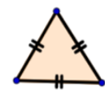
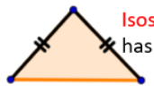

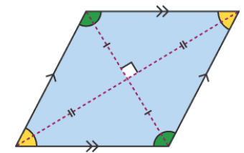
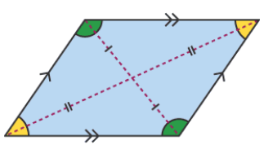
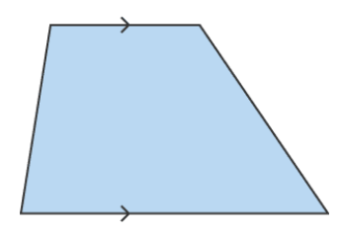

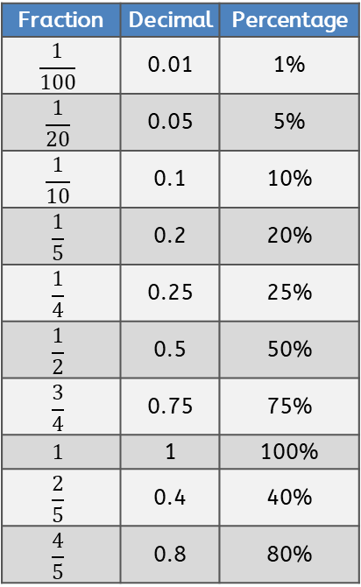
Approximate conversion between imperial and metric units
inch | cm | pound | kg | pint | ml
1 | 2.5 | 1 | 0.5 | 1 | 0.6
Square Numbers
1² | 1 x 1 | 1 |  | 7² | 7 x 7 | 49
2² | 2 x 2 | 4 |  | 8² | 8 x 8 | 64
3² | 3 x 3 | 9 |  | 9² | 9 x 9 | 81
4² | 4 x 4 | 16 |  | 10² | 10 x 10 | 100
5² | 5 x 5 | 25 |  | 11² | 11 x 11 | 121
6² | 6 x 6 | 36 |  | 12² | 12 x 12 | 144
Acute angle | Right angle | Obtuse angle | Full turn = 360º Half turn = 180º Angles inside of a triangle = 180º Angles inside of a quadrilateral = 360º Straight line angle = 180º
Less than 90˚ | Exactly 90˚ | More than 90˚ but less than 180˚
Cube Numbers
1³ | 1 x 1 x 1 | 1
2³ | 2 x 2 x 2 | 8
3³ | 3 x 3 x 3 | 27
4³ | 4 x 4 x 4 | 64
5³ | 5 x 5 x 5 | 125
Equilateral triangle | Isosceles triangle | Scalene triangle | Right angled triangle
3 equal sides and 3 angles of 60° | 2 equal sides and 2 equal angles | No equal sides or angles | One angle is a right angle (90°)
Fraction | Decimal | Percentage
$$\frac{1}{100}$$ | 0.01 | 1%
$$\frac{1}{20}$$ | 0.05 | 5%
$$\frac{1}{10}$$ | 0.1 | 10%
$$\frac{1}{5}$$ | 0.2 | 20%
$$\frac{1}{4}$$ | 0.25 | 25%
$$\frac{1}{2}$$ | 0.5 | 50%
$$\frac{3}{4}$$ | 0.75 | 75%
$$1$$ | 1 | 100%
$$\frac{2}{5}$$ | 0.4 | 40%
$$\frac{4}{5}$$ | 0.8 | 80%
Parallelogram | Rhombus | Trapezium
Two pairs of parallel sides | All sides have the same length and are parallel | One pair of parallel sides
Key Roman Numerals
One | 1 | I
Five | 5 | V
Ten | 10 | X
Fifty | 50 | L
One hundred | 100 | C
Five hundred | 500 | D
One thousand | 1,000 | M
  Prime Numbers up to 20
2 3 5 7 11 13 17 19
A prime number has exactly two factors

